Slide 1
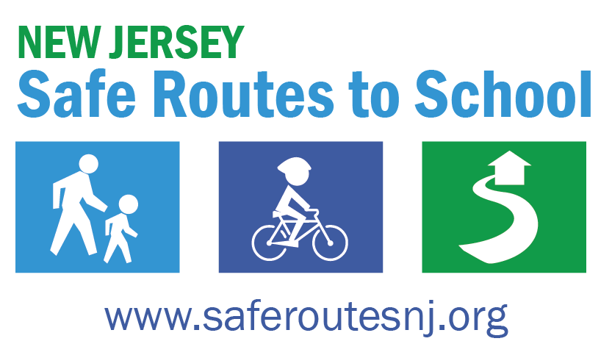
Bicycle safety Grades 3-8
Notes:
Say: Today we are going to learn about the steps to biking safely.

Slide 2
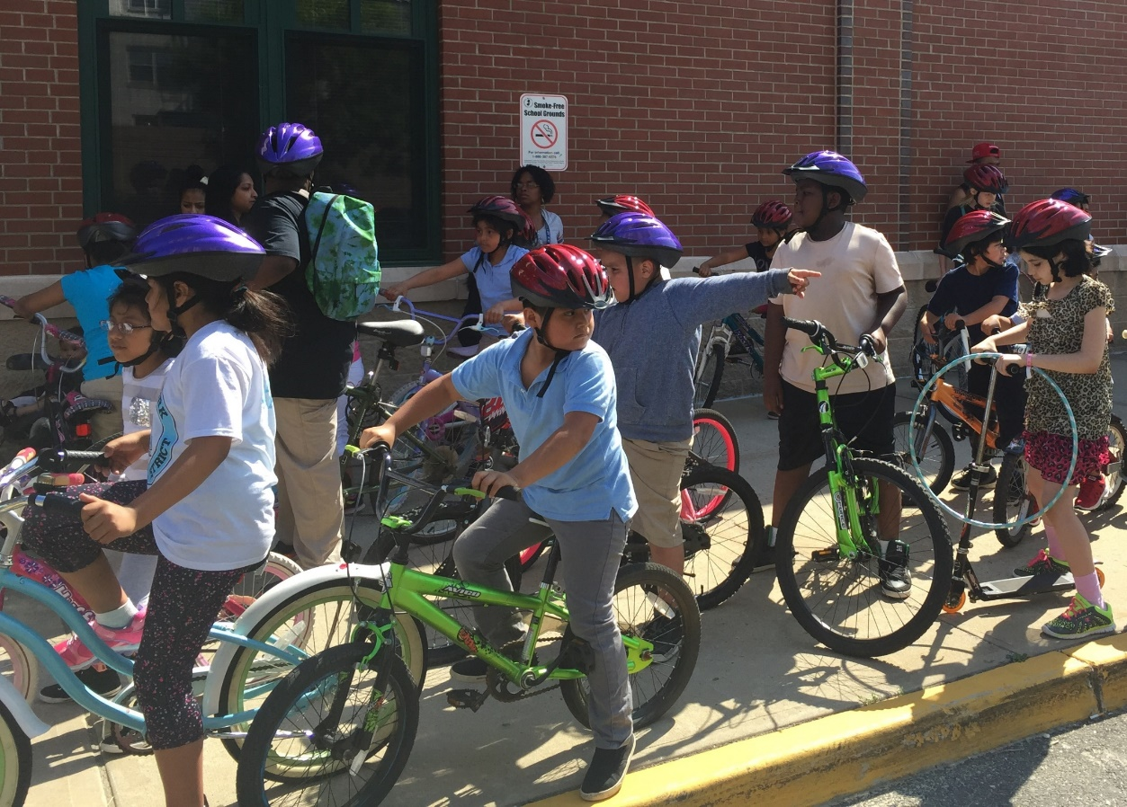
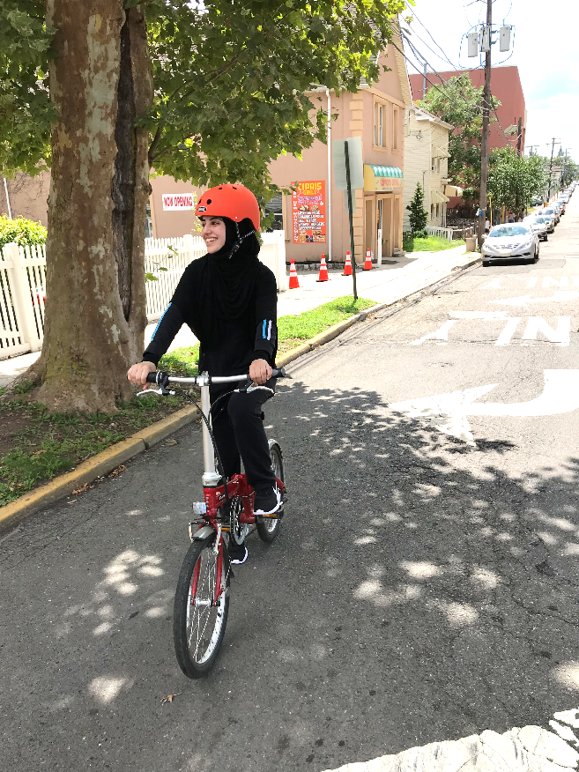
6 KEY RULES!
Ride WITH traffic
Obey all traffic signs/
signals
Use hand signals
Ride in a straight line
Be visible
Wear a helmet
Notes:
There are six key rules for bicycling!
Wear a helmet
Ride in the same direction as traffic
Obey all traffic signs/signals
Use hand signals
Ride in a straight line
Be visible

Slide 3
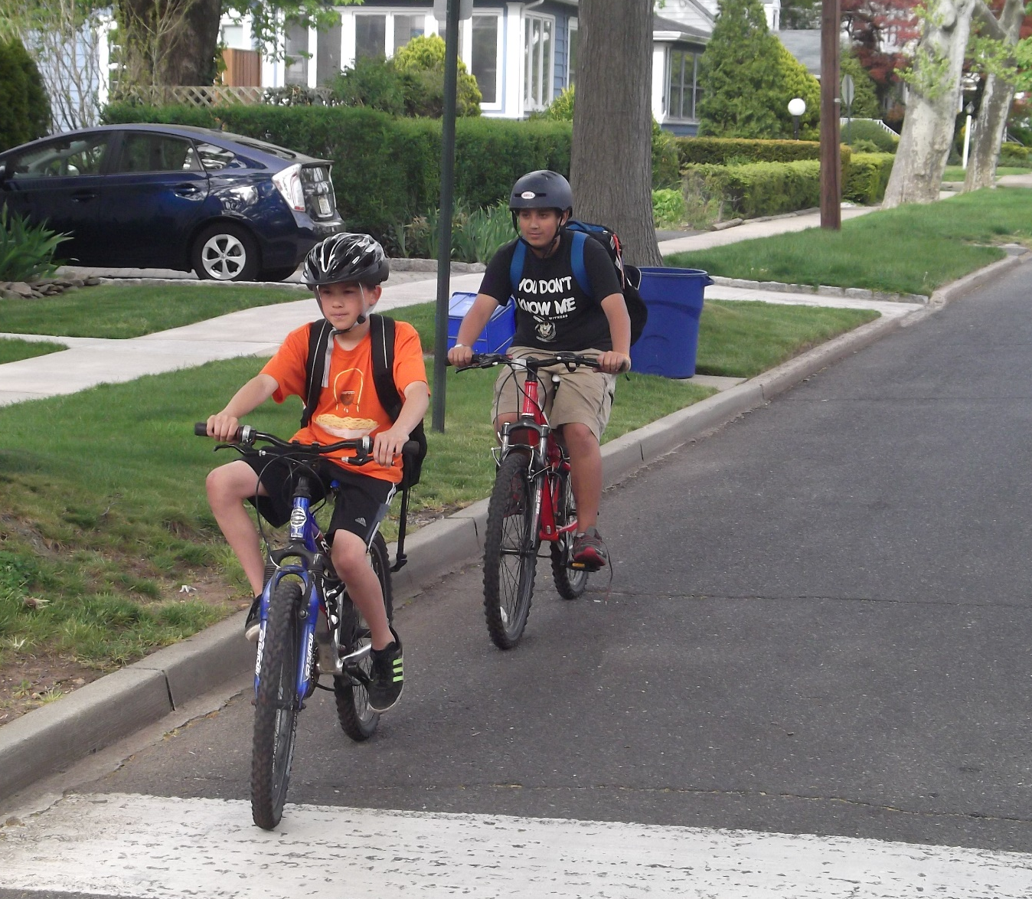
1. WEAR A HELMET
Notes:
Ask: Who can tell me why wearing a helmet is very important?
Answer: Wearing a helmet can help protect your head and brain if you happen to fall or get into a crash while biking.

Slide 4
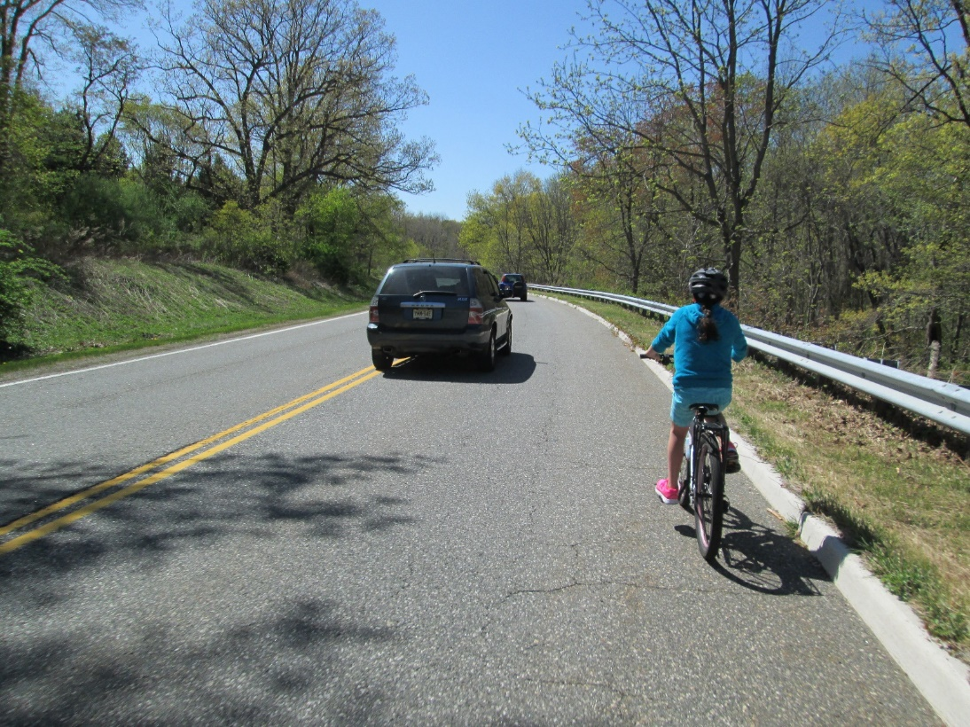
2. RIDE WITH TRAFFIC
Notes:
Say: The first rule is to ride WITH traffic. This means that you are riding in the same direction as the traffic is moving. This way, drivers can see you. When you’re riding your bike in the road, you are treated like a car! So, if you’re out on the road and a car is going straight, you should be driving straight too.

Slide 5
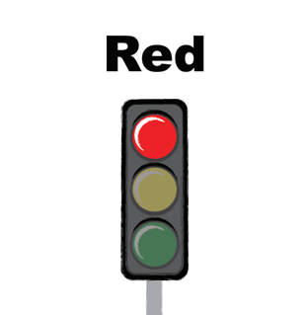
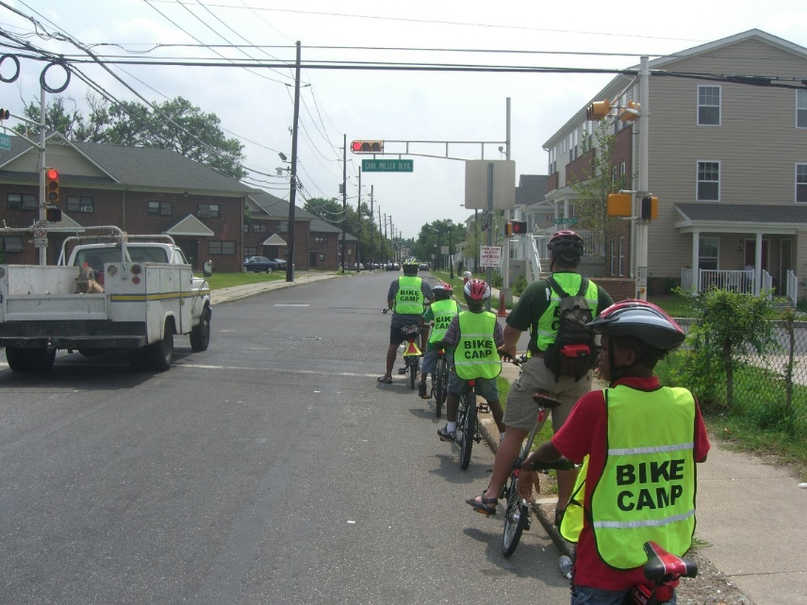
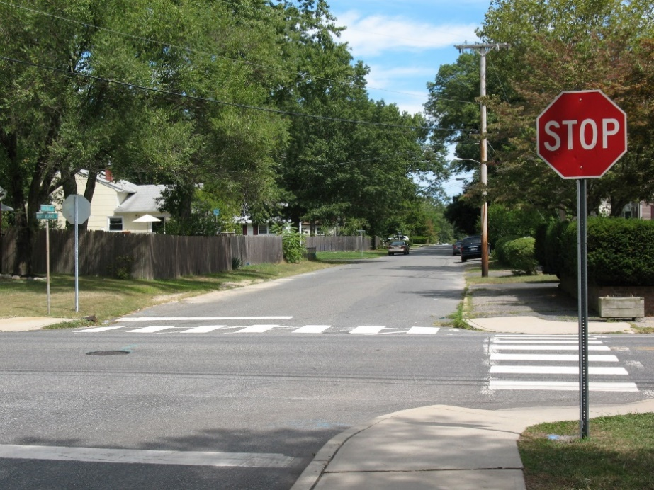
3. OBEY ALL TRAFFIC SIGNS AND SIGNALS
Notes:
Say: Remember you must obey traffic signs and signals. Just like cars, when you’re riding your bike, you have to stop at STOP signs and RED lights, and watch out for people walking! Keep in mind, you still need to use your eyes and ears to listen to what’s going on around you.

Slide 6
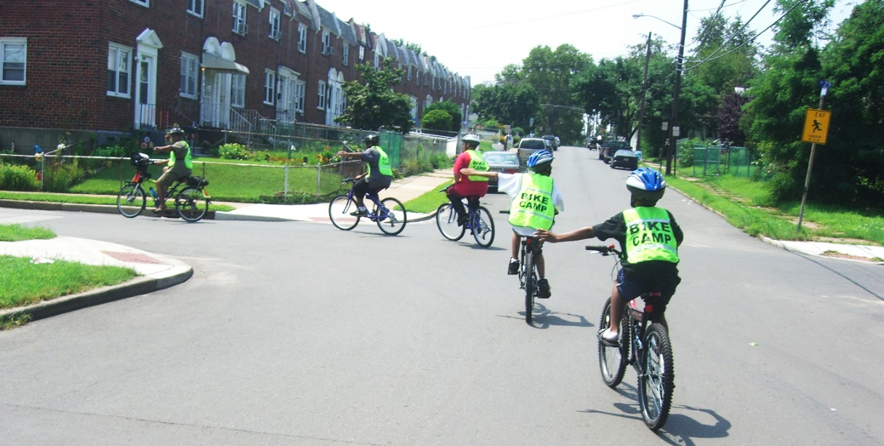
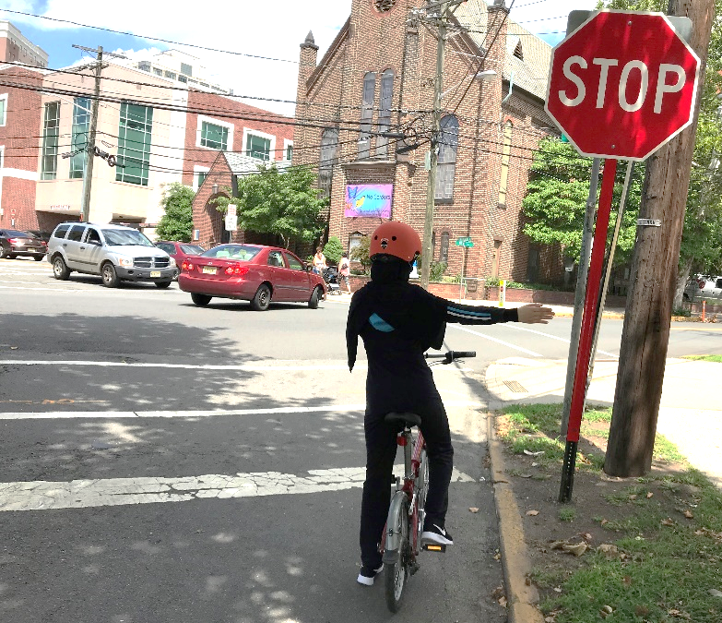
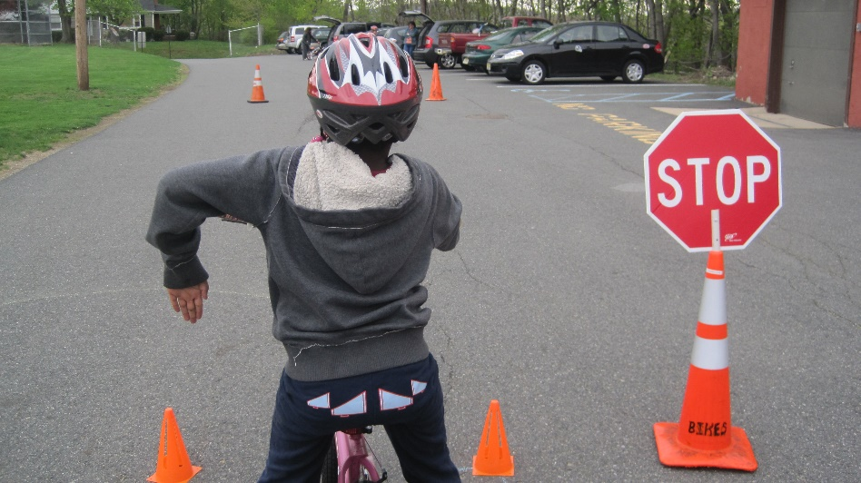
4. USE HAND SIGNALS
LEFT
RIGHT
STOP
Notes:
Say: Let’s practice together! Everyone please stand up, and let’s do this together. Everyone, signal RIGHT (they signal). Now signal left (they signal). And finally, signal to STOP (they signal). Great job everyone, and now a round of applause for yourself and your classmates!

Slide 7
5. RIDE IN A STRAIGHT LINE
Notes:
Ask: How can we be predictable while biking? How can keeping straight while biking help us be more predictable?
Answer: Riding in a straight line is very important. If you keep straight instead of weaving back and forth in front of or between cars, you won’t hit other bikers and it helps you to be more predictable so that drivers know where you’re going.

Slide 8
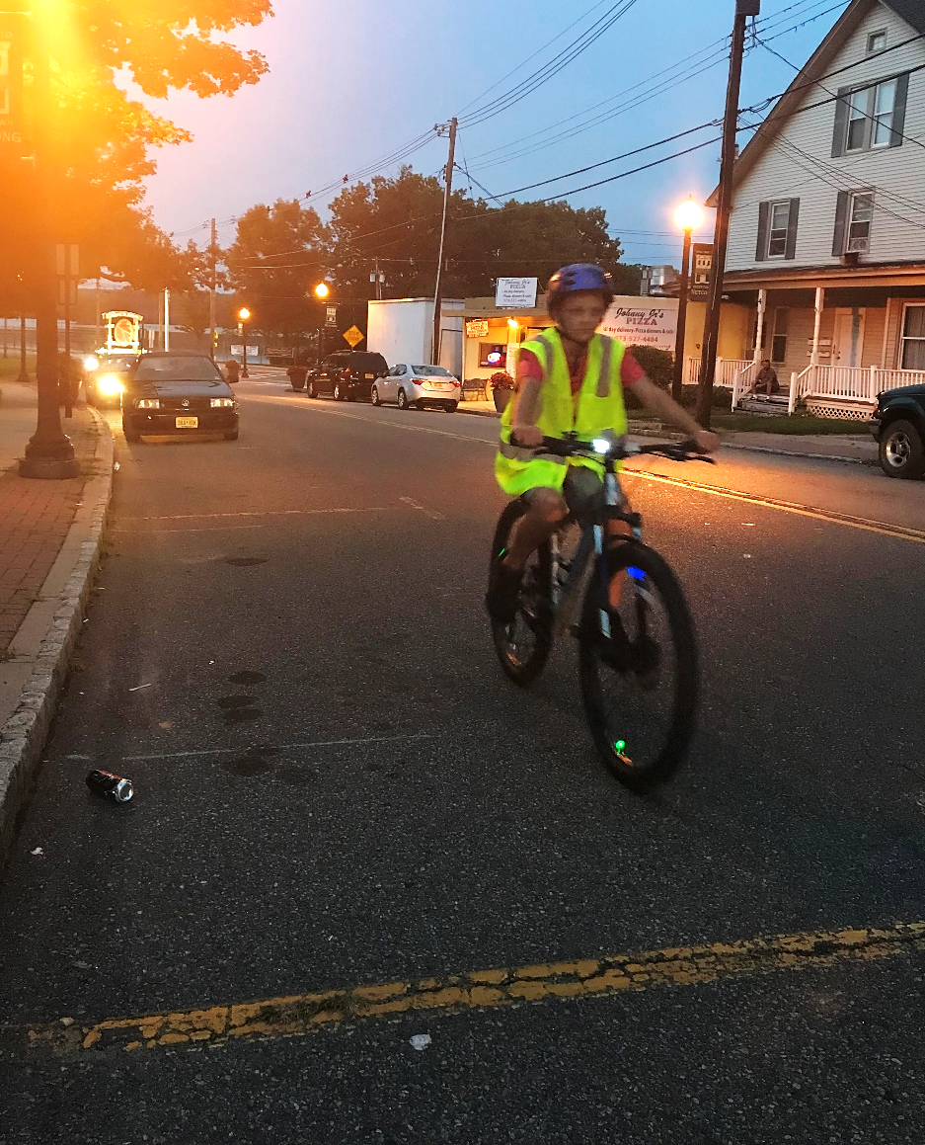
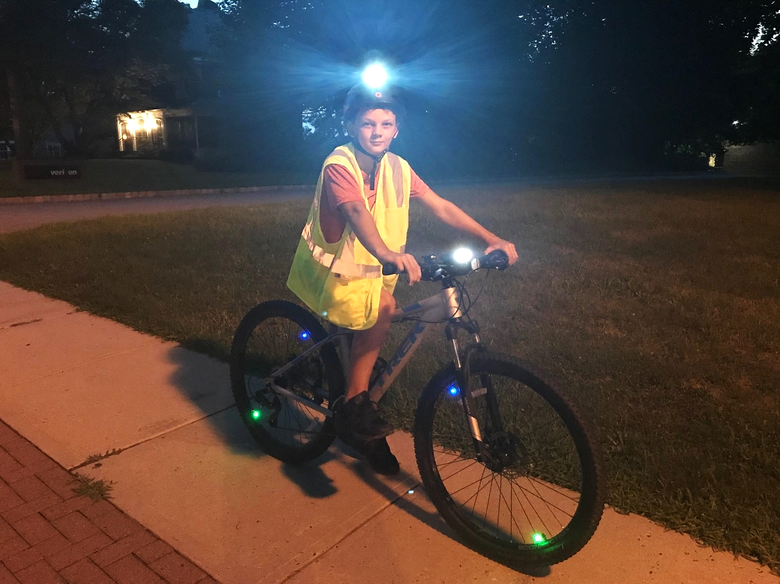
6. BE VISIBLE
Notes:
Say: Being visible is also an important biking rule! This is especially important if you’re riding at night, you need to make sure that you have working lights.

Slide 9
POP QUIZ: The Helmet Law
Up to what age are students required to wear bicycle helmets in NJ?
A) 10 B) 14 C) 17
C) New Jersey law requires all children under the age of 17 to wear a properly fitted and fastened bicycle helmet while bicycling, roller skating, in-line skating or skateboarding.
The statute also requires that children wear helmets when riding in restraining seats or in trailers towed by a bike.
Notes:
Ask the question
wait for a response
present the students with the correct answer if not given
discuss why the answer given is the correct one.
Say: Be responsible and wear your helmet. Wearing a helmet can help prevent possible brain damage that may result from a crash.

Slide 10
HELMET FIT
A
B
C
Notes:
Say: Now, we are going to find out the right way to wear a helmet while biking.
Ask: By a show of hands, who here thinks that A is the correct way to wear a helmet?
Ask: By a show of hands, who here thinks that B is the correct way to wear a helmet?
Ask: By a show of hands, who here thinks that C is the correct way to wear a helmet?
Answer: C is the correct answer!
Say: To figure out for yourself that your helmet fits right, follow these two rules. After you put your helmet on:
there should be space for one or two fingers on your forehead, above your eyebrows
there should be space for one or two fingers between the chin strap and your chin
If your fingers fit in both areas, then your helmet is well-fitted for your head and you’re good to go!

Slide 11
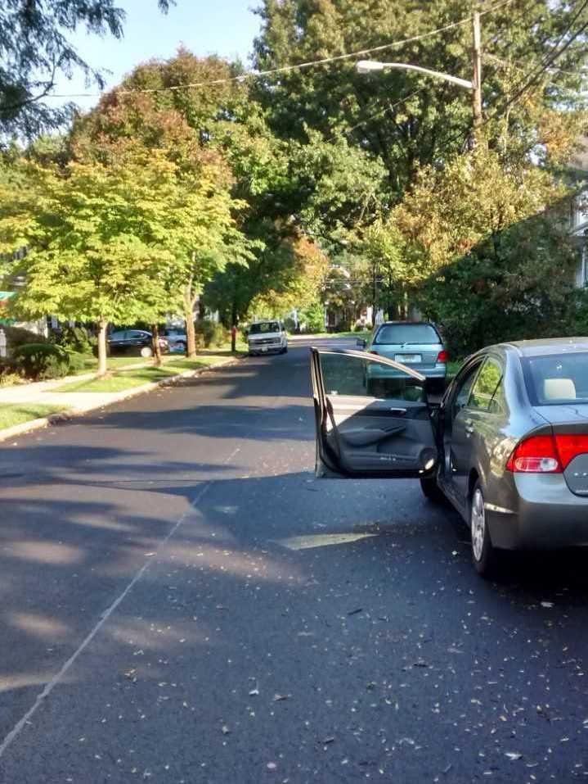
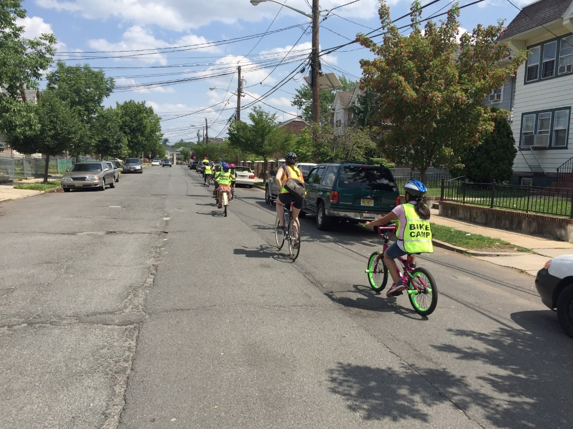
WHAT IS THE “DOOR ZONE”?
Notes:
Ask: What is the door zone?
Answer: The space that the open door of a parked car occupies. If you’re riding in the door zone and a driver or a passenger opens the door, you might ride into it.
Ask: How can we avoid a collision between us and a car in the “door zone”?
Possible answers:
Slow down near parked cars
Keep an eye out for drivers opening their doors
Keep a safe distance when possible
Ride with three feet between you and parked cars
Say: If you are getting out of a car, look for bicyclists before you open the door.

Slide 12
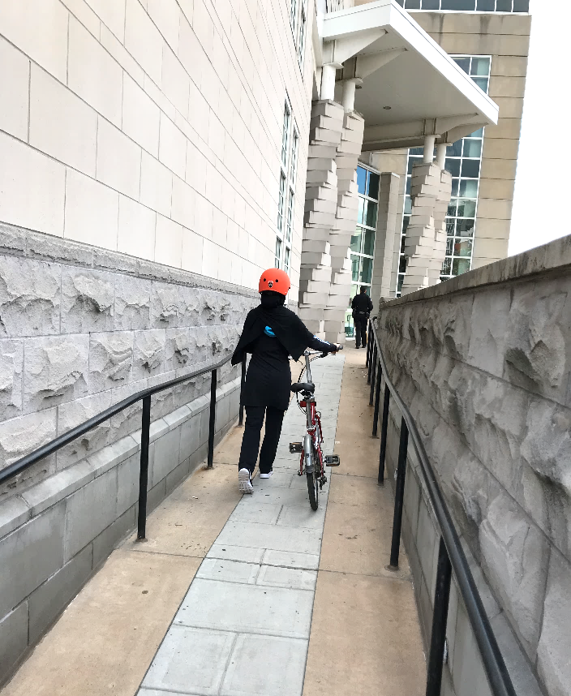
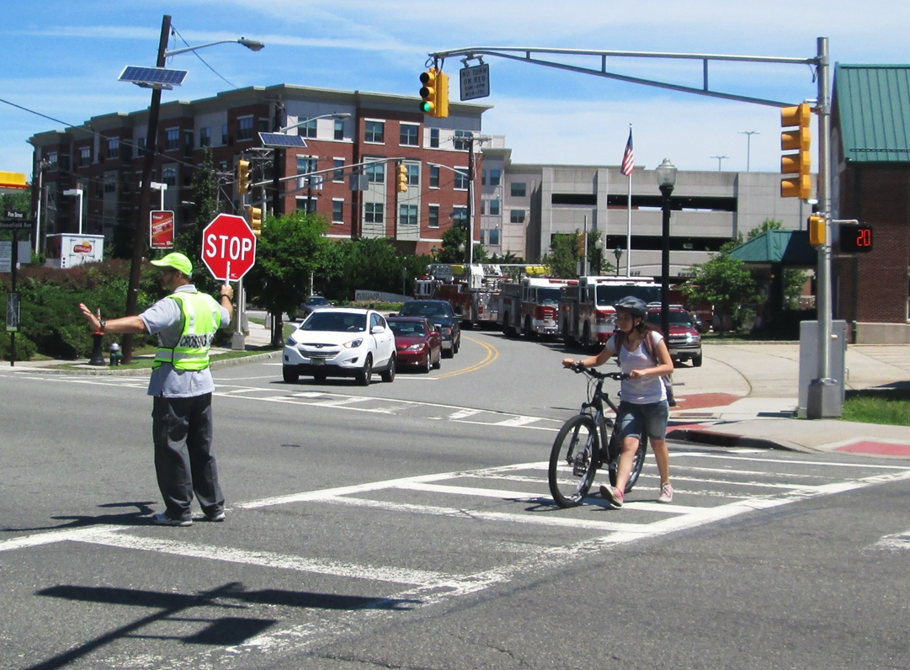
WALK YOUR BIKE
Notes:
Say: If there is a lot of traffic and you don’t feel safe riding across the road, then find a crosswalk, and walk your bike to get to the other side.

Slide 13
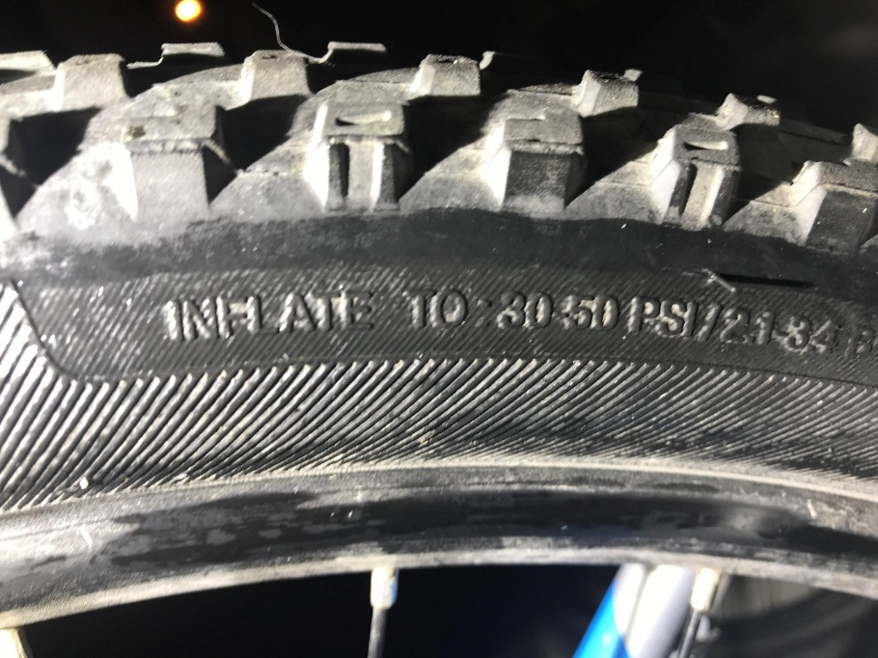
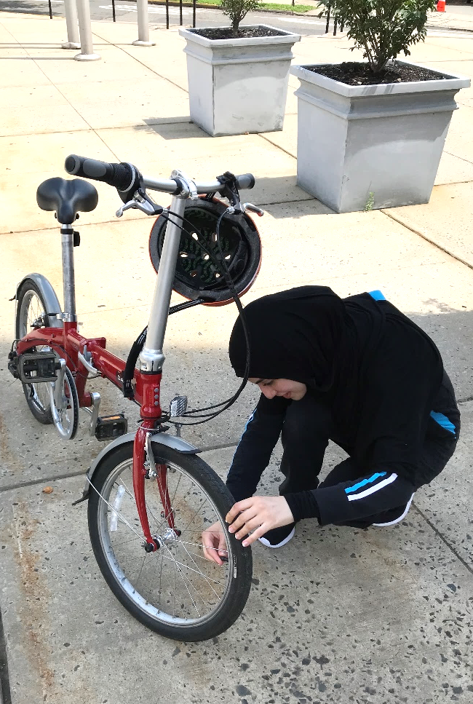
ABC QUICK CHECK
AIR
Notes:
Say: A is for AIR: Check the air pressure, spin the wheels and make sure the tires are not worn out.
ASK: Do you know how to check if you’ve filled it enough?
ANSWER: Look for the PSI on your bike tire, then try to squeeze the tire, make sure it’s firm. If it’s not firm, look for the pressure range on the side of the tire, and make sure it’s filled within that range.

Slide 14
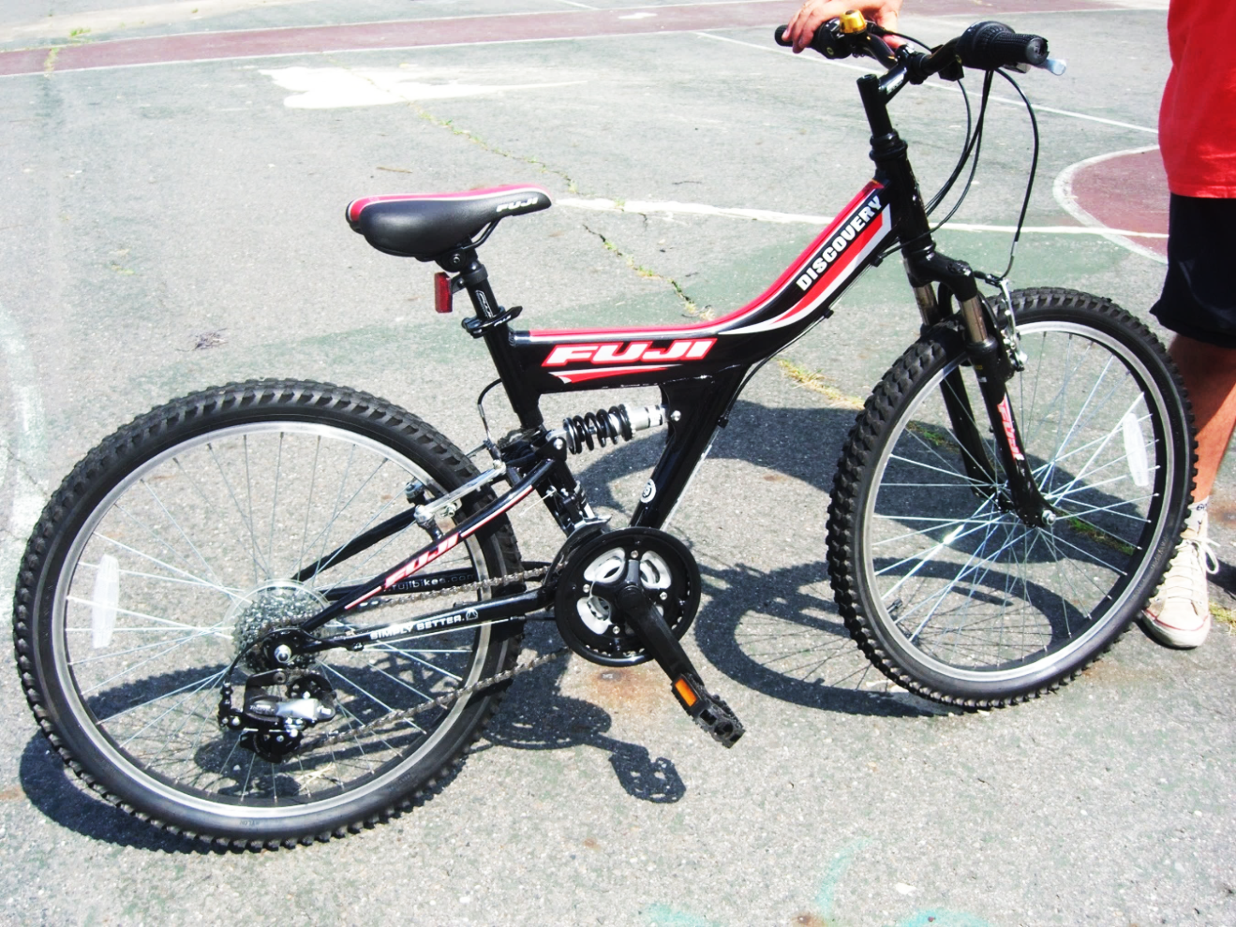
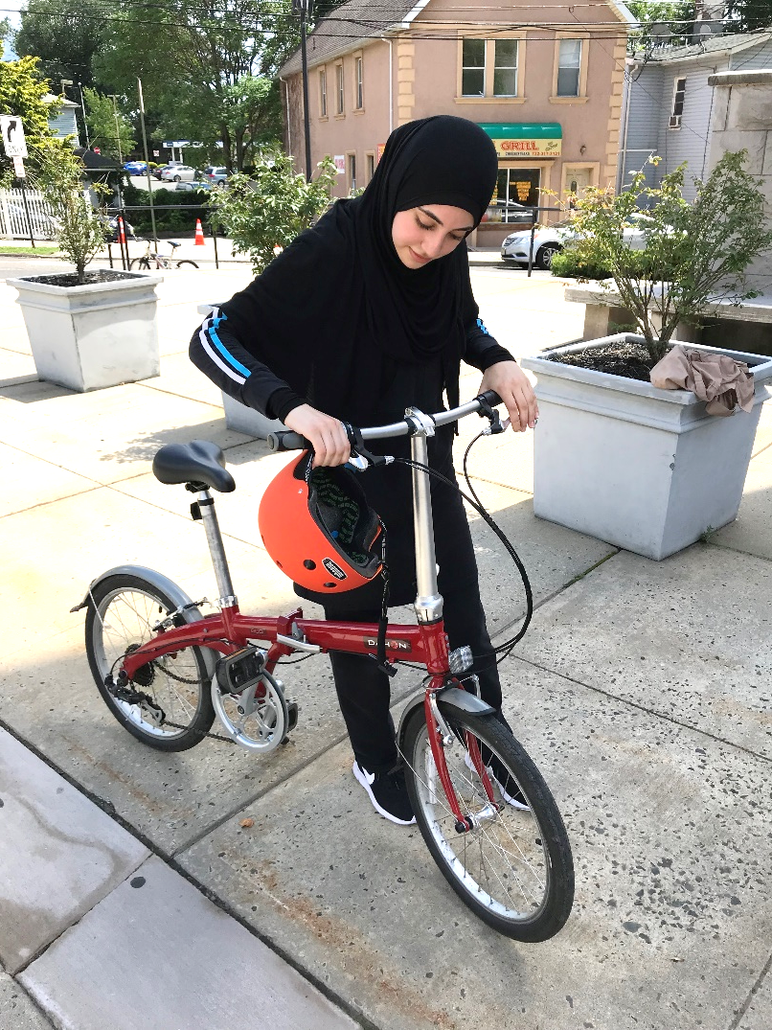
ABC QUICK CHECK
BRAKES
Notes:
Say: Check to make sure your hand brakes will stop the bike by spinning the back wheel and applying the brake. Lift one tire up at a time and spin it; squeeze the levers to see if the tire stops.
Note: If a bicycle has coaster brakes, the rider will stop the bicycle by peddling backwards.
If the brakes don’t work, don’t ride your bike until you get them fixed.

Slide 15
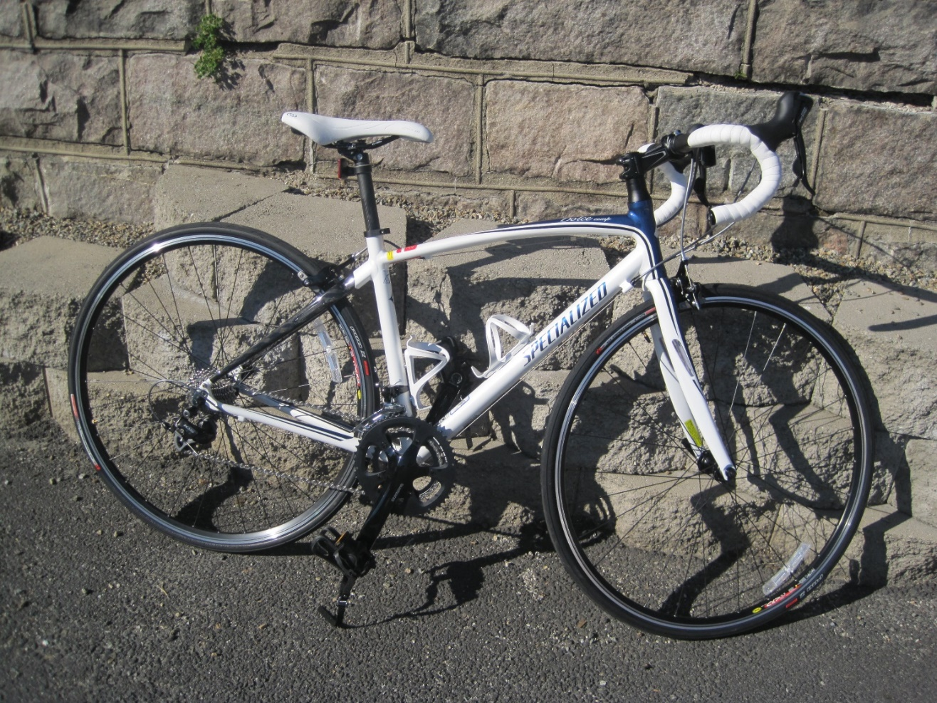
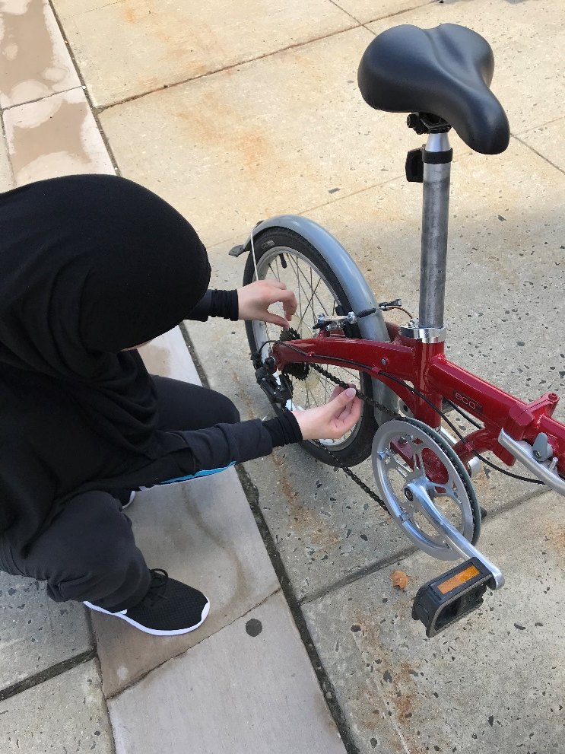
ABC QUICK CHECK
CRANKS/CHAIN
Notes:
Say: Grab the crank arms and try to wiggle side to side. There should be no movement. Spin the pedals and cranks to see if the chain drives the rear wheel. The chain should look like metal not rust or black gunk. If the bike has gears check to make sure the gear levers and derailleurs (gear-changing mechanism) work to shift the chain between gears.

Slide 16
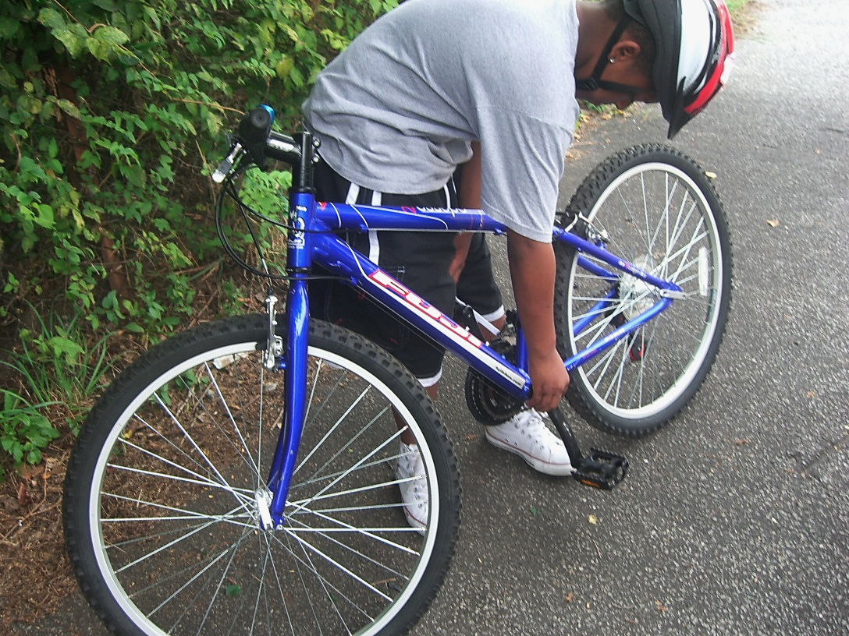
ABC QUICK CHECK
QUICK RELEASE
Notes:
Say: Some bikes have quick releases on the wheels or the seat post. Check to make sure they are tight and closed properly and won’t catch on your clothing.

Slide 17
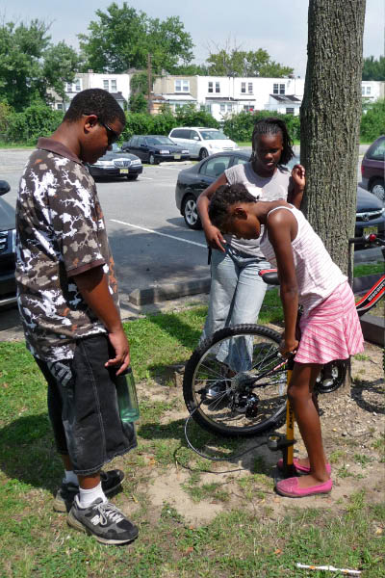
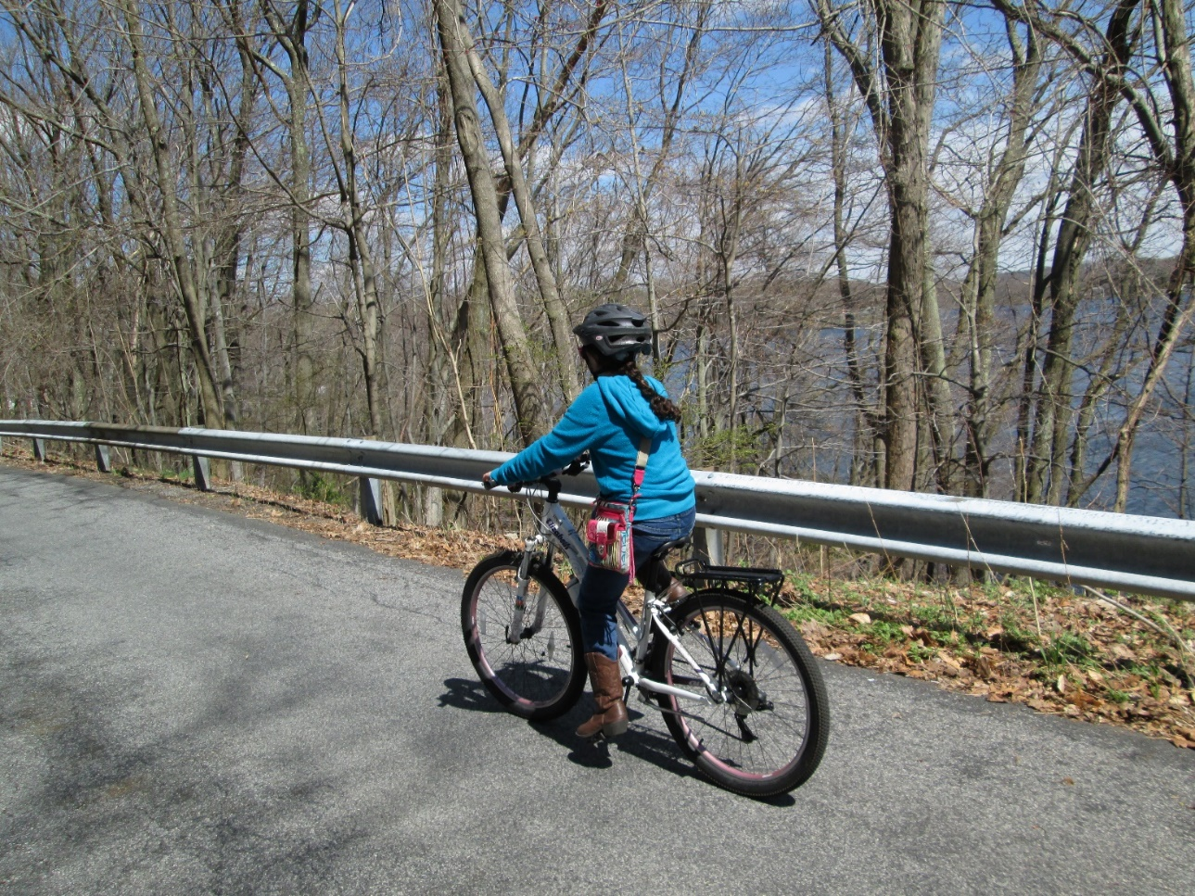
ABC QUICK CHECK
Notes:
Say: After making sure the seat and handlebars are tight, ride the bicycle around in a safe area where there are no moving cars, and check that everything works well.
SOURCE: FHWA
PedBikeInfo

Slide 18
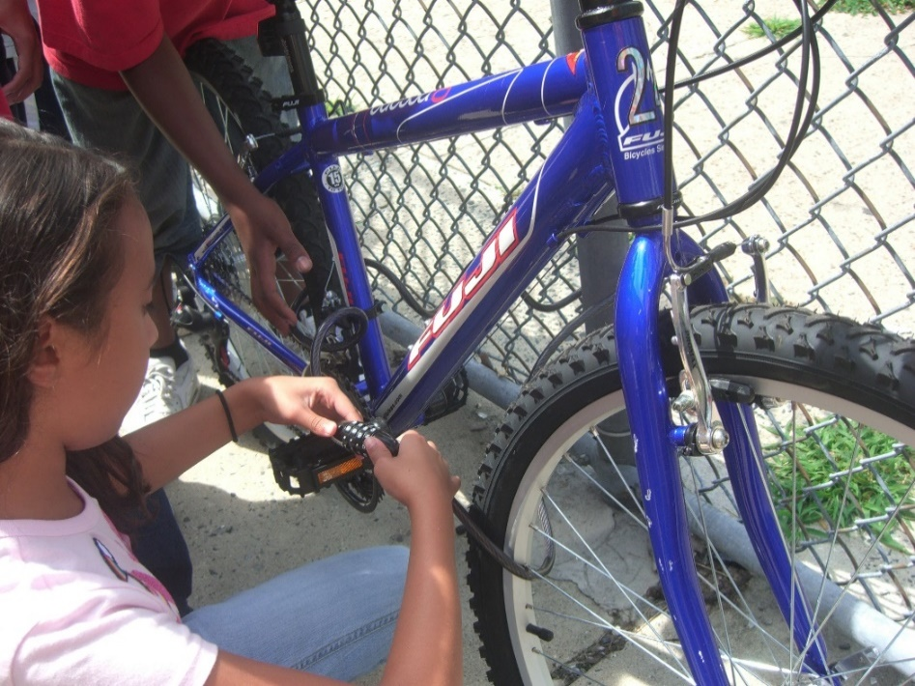
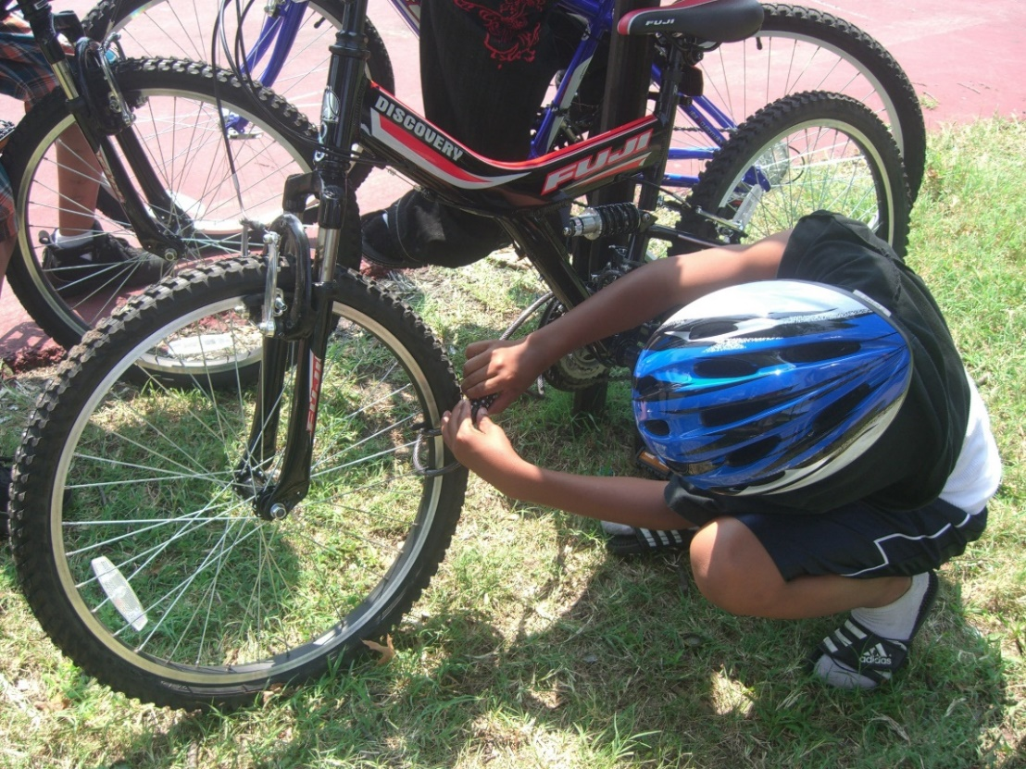
LOCK UP
Notes:
Say: If you have to leave your bike somewhere, make sure you lock it properly!

Slide 19
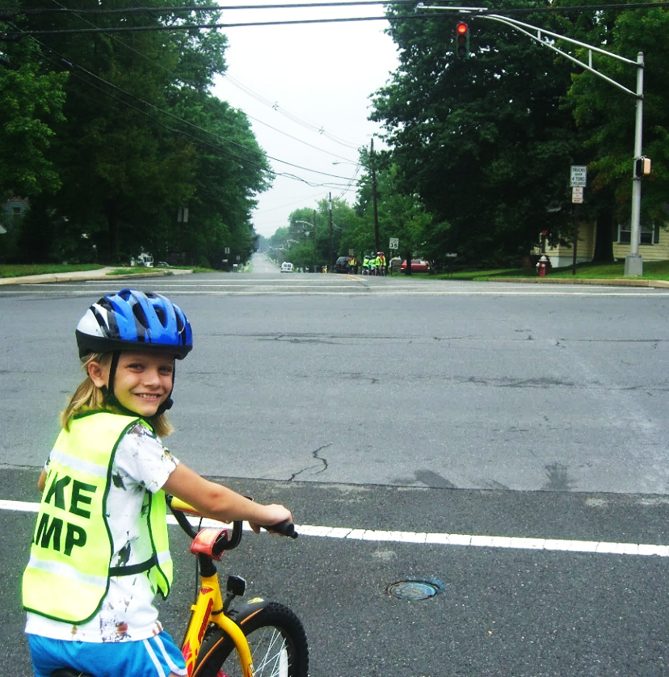
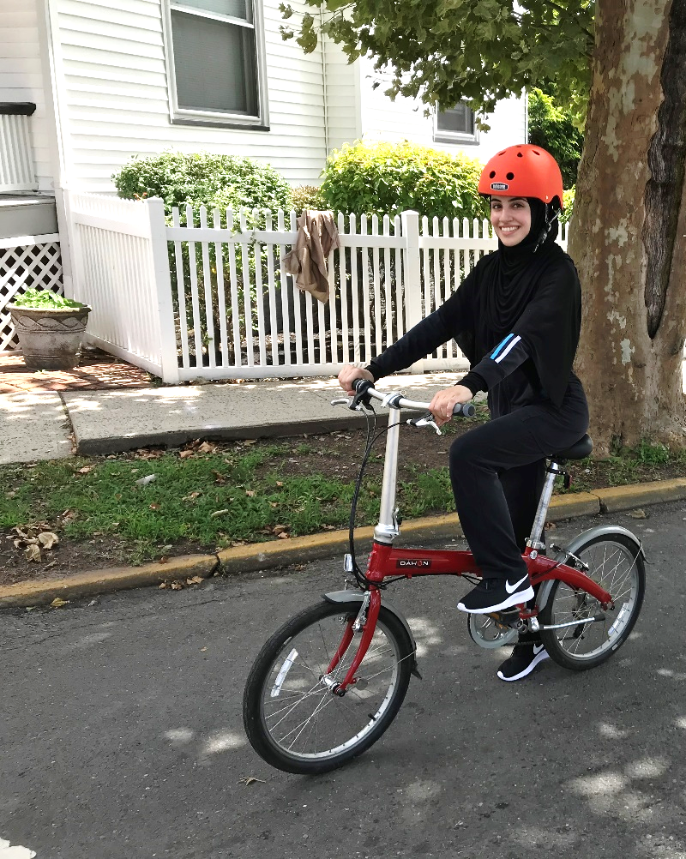
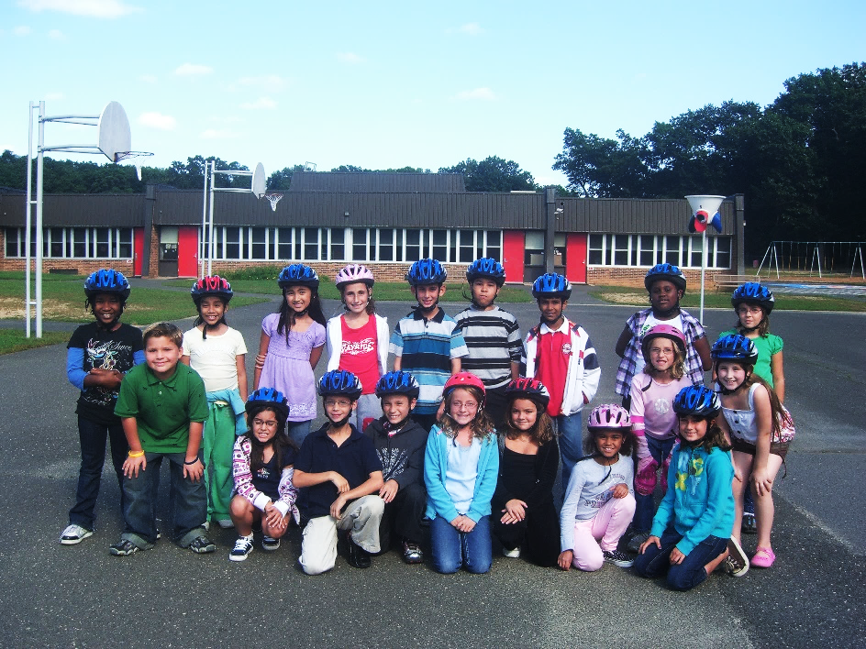
THANK YOU!
When we all practice safe biking, it is easy to be safe, get exercise, and have FUN!
Notes:
In conclusion, there are 5 things to know:
Get your bike checked out
Wear your helmet
Have fun!!
SOURCE: The Active Transportation Alliance

